Slide 1
Laser Light Show
ELEC 391 – Group B1

Slide 2
Simulink Model

Slide 3
RCGs
Requirements
Constraints
Control Frequency of 1000 Hz
Max Motor Current ( < 2A )
Goals
Rise Time ( < 0.017 s )
Overshoot ( < 10 % )
Max Encoder Resolution ( 400 pulses )
Simulink Model of Motor Within 5 % Error
Support shapes with >5 vertices
2 non-commercial motors
Motion in X – Z plane
Real time control system
All circuits on PCBs
Basic animation of shapes
No breadboards
Laser light

Slide 4
The Process
Building Motors
System Integration
Control

Slide 5
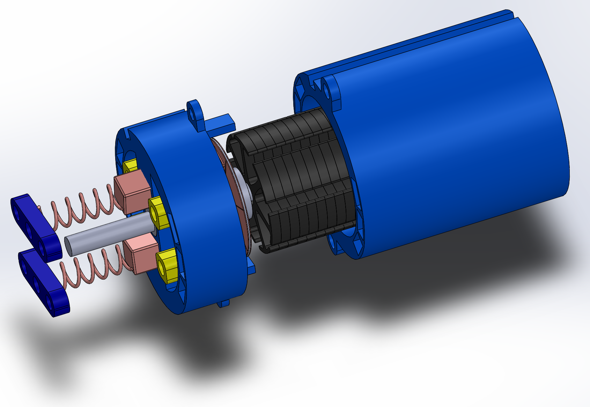
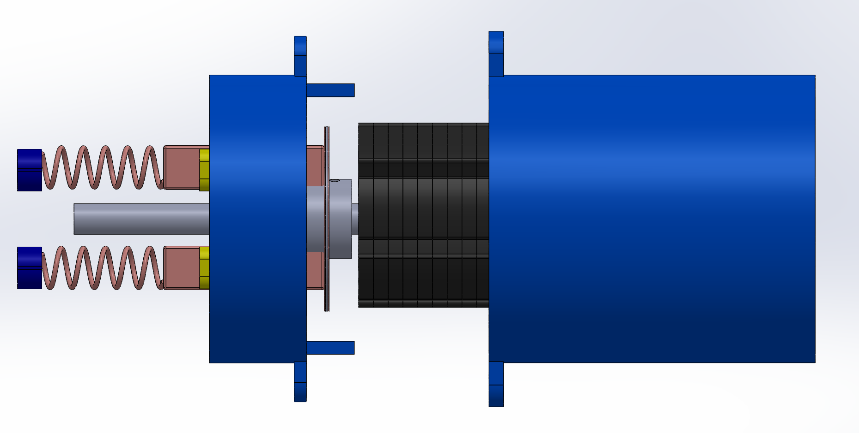
YAW MOTOR
Description
Steel rotor core (helical)
Closed casing
Disk commutator
Spring mechanism for the carbon brush
Strong connection between front & back casing using nuts/bolts
 | Starting | Minimum | Maximum
Current (A) | 1.5 | 1 | 2.15
Speed (RPM) | -- | 1420 | 6600

Slide 6
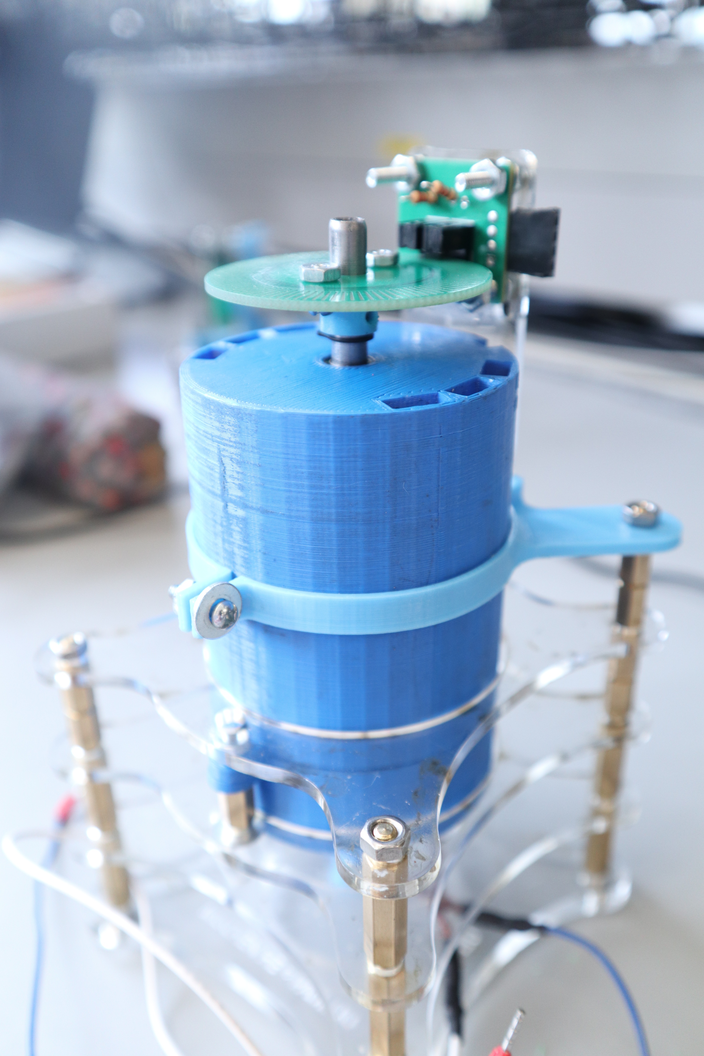
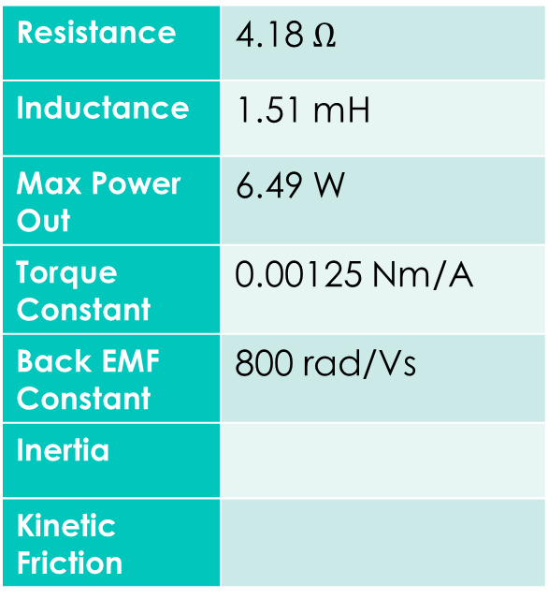
YAW
Resistance | 4.18 $Ω$
Inductance | 1.51 mH
Max Power Out | 6.49 W
Torque Constant | 0.00125 Nm/A
Back EMF Constant | 800 rad/Vs
Inertia
Kinetic Friction

Slide 7

Step Response

Slide 8
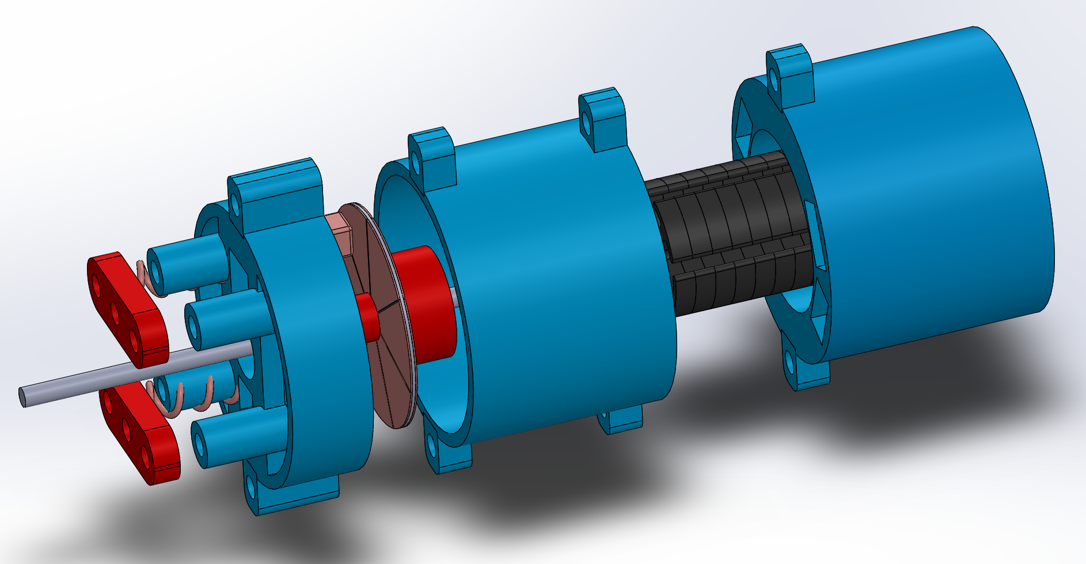
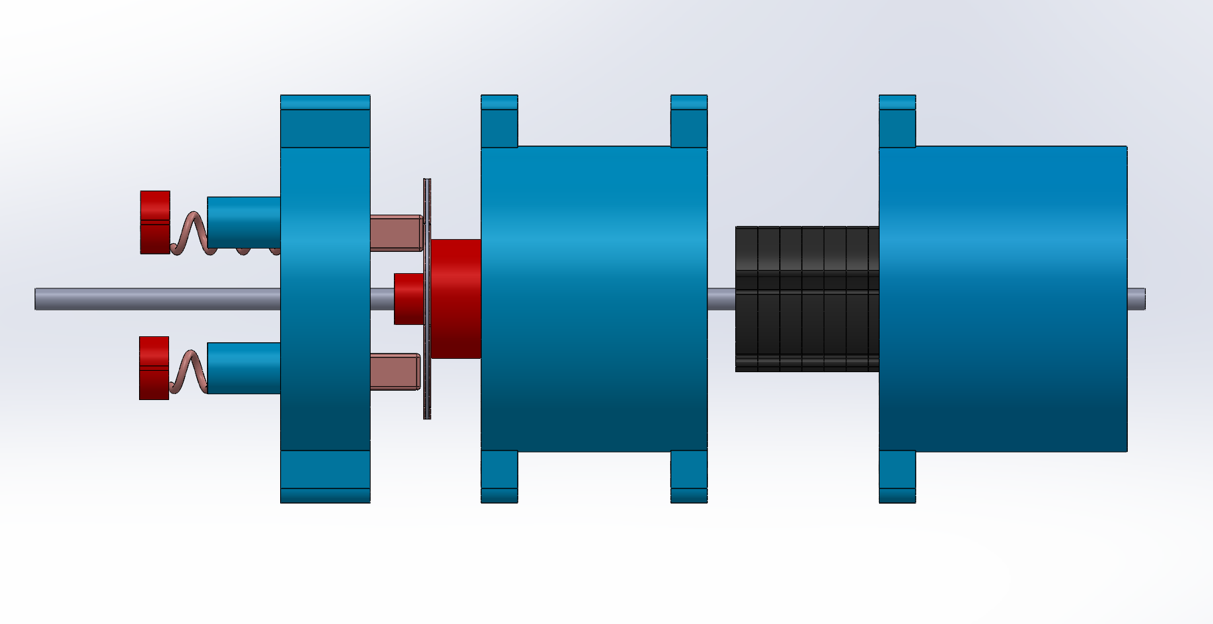
PITCH MOTOR
Description:
Scaled down version of yaw motor
Steel rotor core (helical)
Closed casing
Spring mechanism for the carbon brush
Strong connection between front & back casing using nuts/bolts
 | Starting | Minimum | Maximum
Current (A) | 0.3 | 0.28 | 2.0
Speed (RPM) | -- | 1820 | 6000

Slide 9
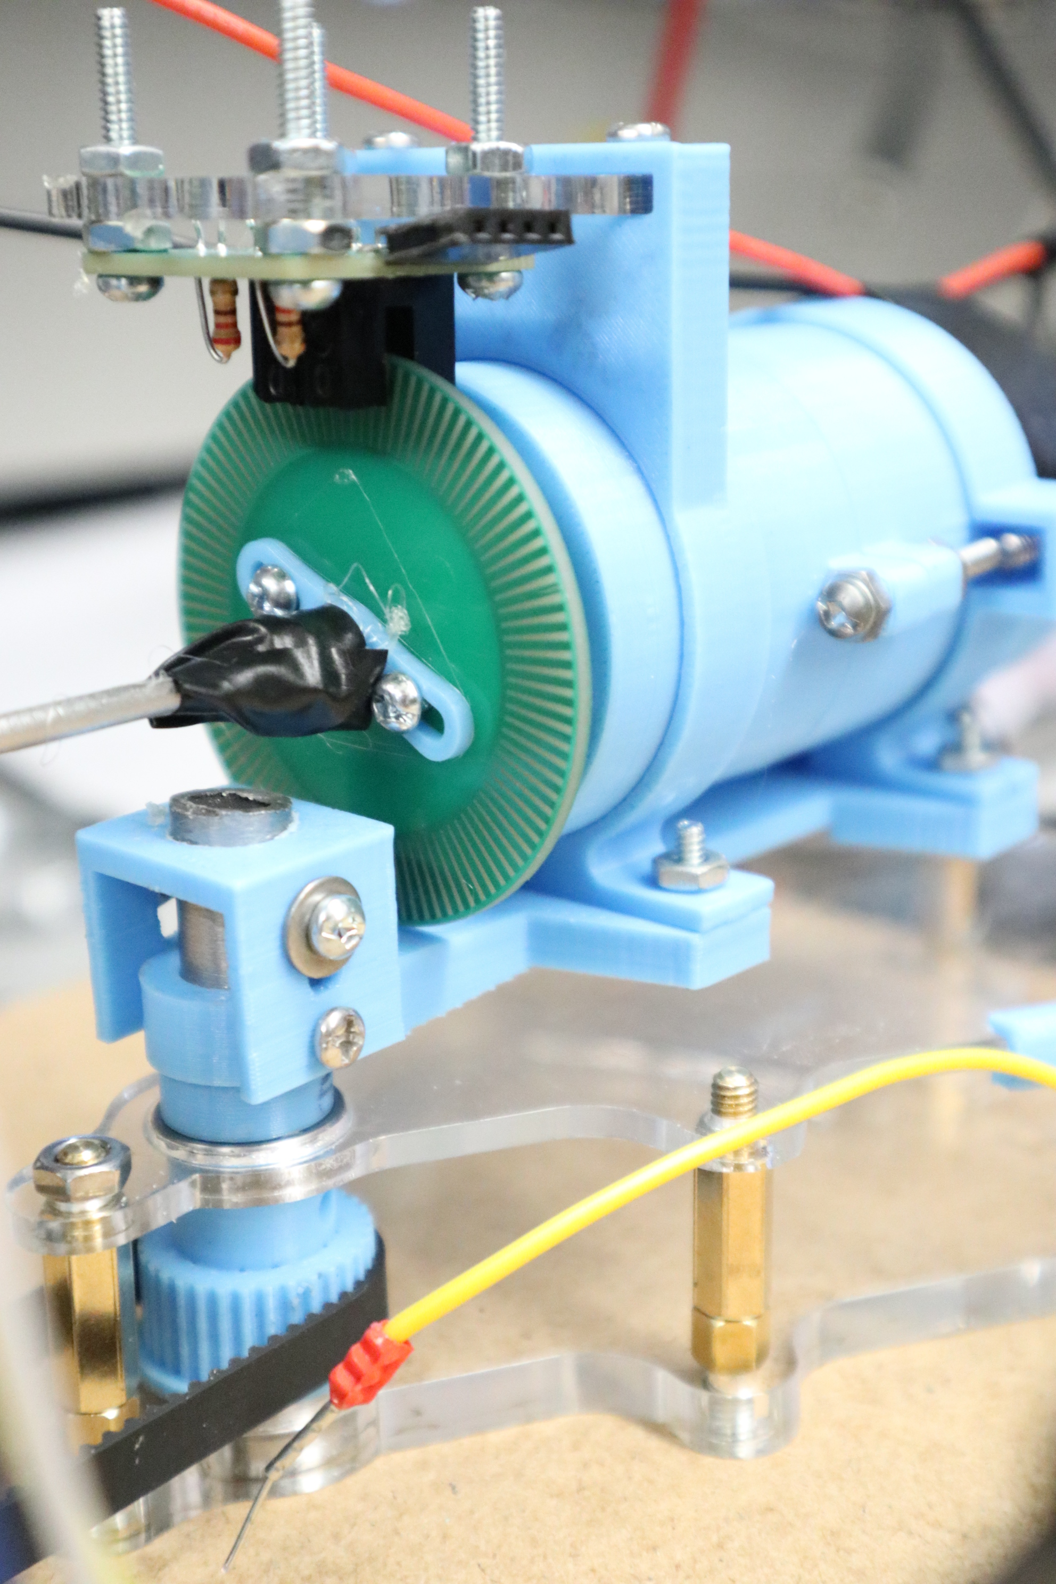
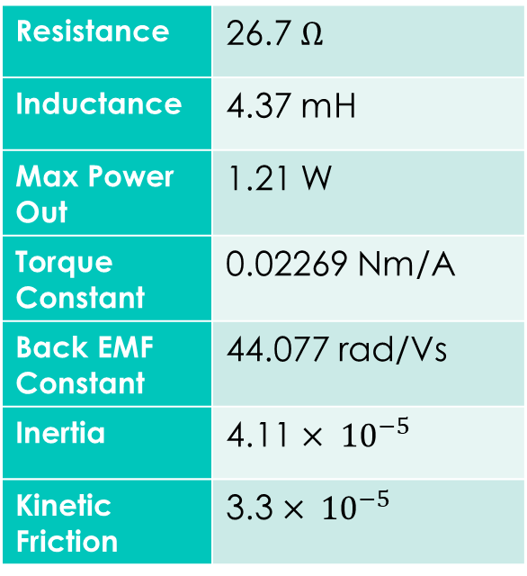
PITCH
Resistance | 26.7 $Ω$
Inductance | 4.37 mH
Max Power Out | 1.21 W
Torque Constant | 0.02269 Nm/A
Back EMF Constant | 44.077 rad/Vs
Inertia | 4.11 $× {10}^{−5}$
Kinetic Friction | 3.3 $× {10}^{−5}$

Slide 10
Step Response

Slide 11
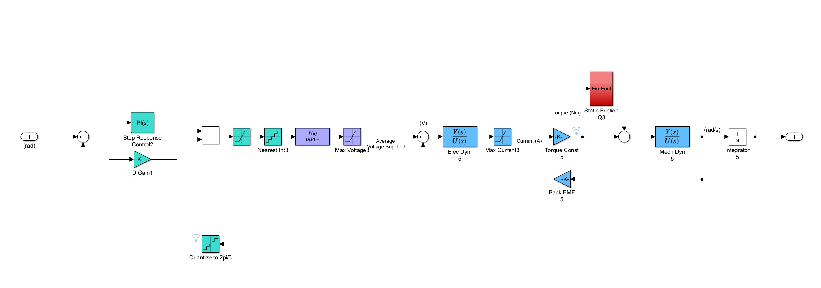
Simulink Model with PID Control
Static Friction and Cogging
PWM Value between
0 - 255
Maps PWM to Average Voltage
Output Position
Input Step
Derivative Gain on Velocity
Quantizes Angle to Encoder Resolution
Motor Transfer Function

Slide 12
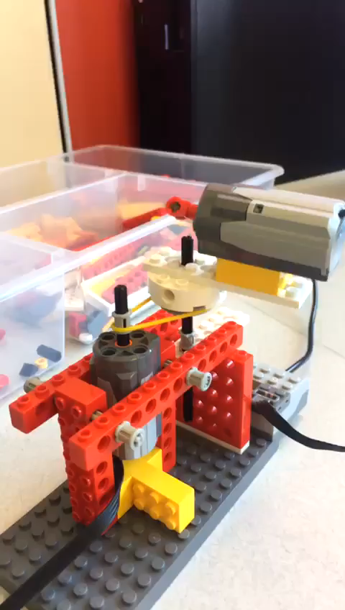
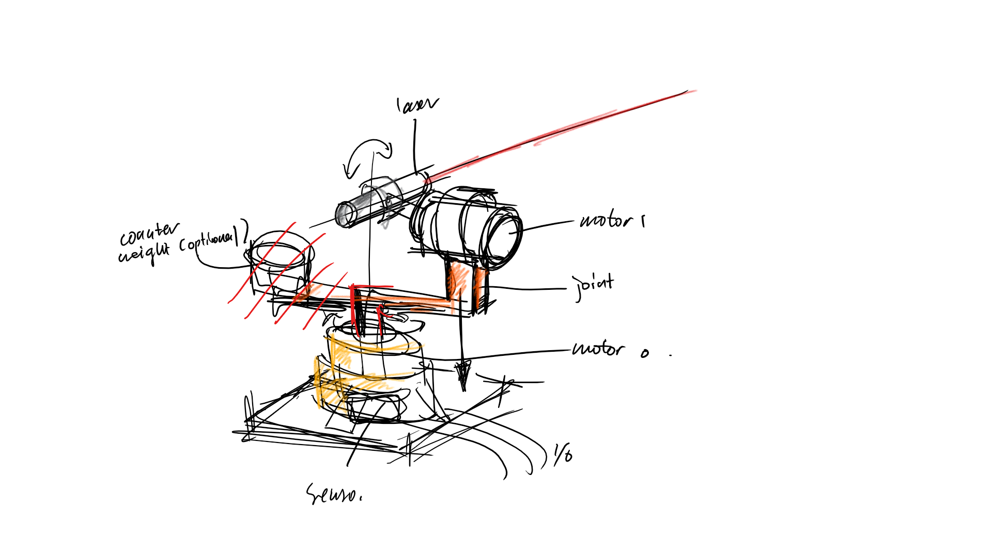
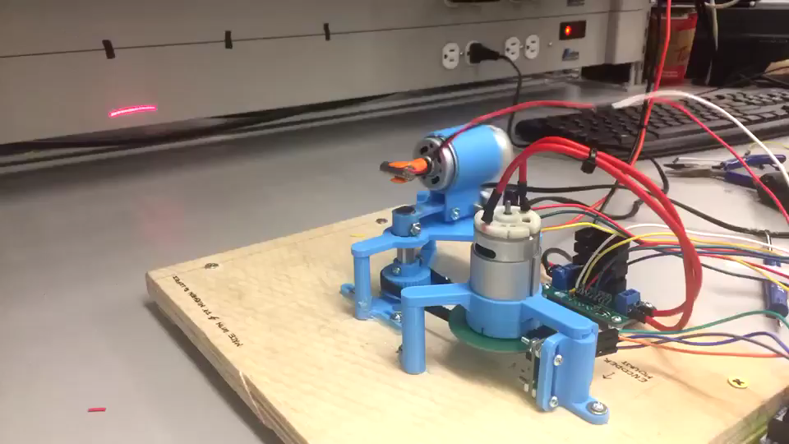
1…
2…
3…
SYSTEM

Slide 13
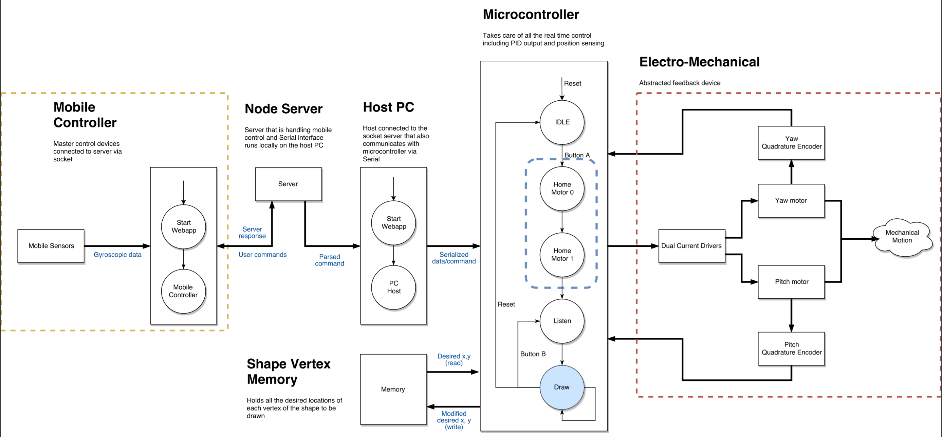
SYSTEM FLOWCHART

Slide 14
Controller Logic
State 1
Homing Yaw Motor
State 2
Homing Pitch Motor
State 3
Listen
State 4
Draw
wait for motor to push limiter switch
wait for laser to hit photoresistor
input desired positions through web app
send to microcontroller
execute control for desired positions

Slide 15
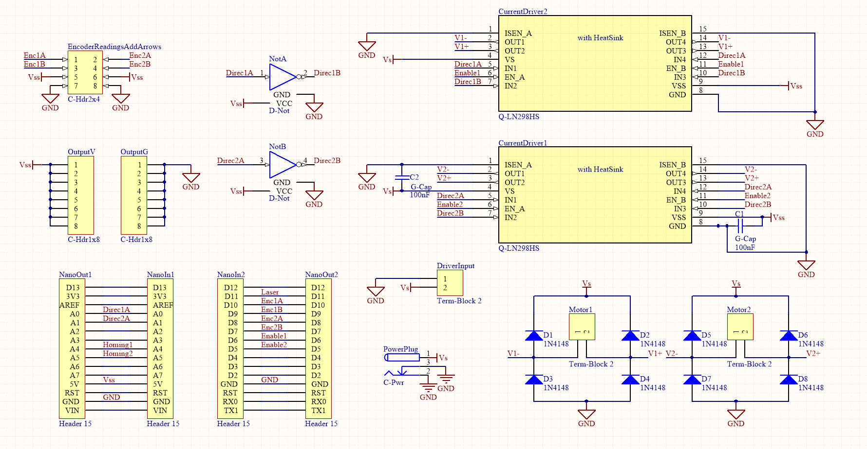
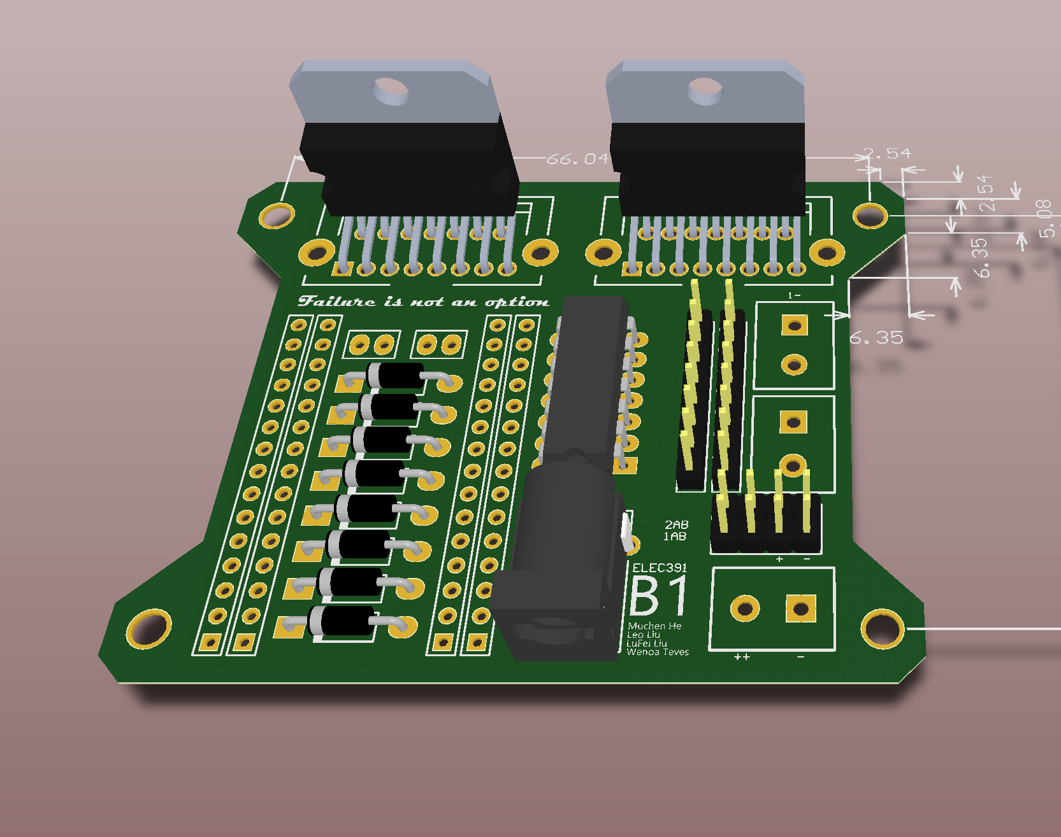
System PCB
Current Drivers
Pins from Encoder
Not Gates (for motor direction)
Extra 5V Pins
12V Input Pins
12V Input Plug
Arduino Base
Diode Bridge

Slide 16
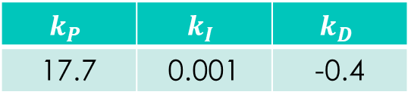
Initial Control
Aim for fastest rise time and small overshoot
Ensure system is stable
Overshoot | 14.28 %
Rise Time | 0.1 s
Settle Time | 2 s
$$k_{P}$$ | $$k_{I}$$ | $$k_{D}$$
17.7 | 0.001 | -0.4

Slide 17




Mapping
1
2
-0.7, 0.6
0.8, -0.2
To Controller
Map desired laser path to list of coordinates
Inverse kinematics are applied to obtain angles
Angles are converted to encoder positions
Time vector is generated based on length of each line segment
3
4
Points:
< n pulses >
Time:
< relative length>
-0.7, 0.6
$$θ1$$
$$θ2$$
0.8, -0.2
$$θ1$$
$θ1$ = 7 pulses

Slide 18
Simulink Model

